Slide 1
Toronto Cycling Infrastructure Questions
Richard Wen
Postdoctoral Fellow
Dalla Lana School of Public Health
University of Toronto
richard.wen@utoronto.ca
July 9, 2024

Slide 2

Research Objectives
For dedicated cycling infrastructure (painted lanes, buffered lanes, and cycle tracks as defined by the Canadian Bikeway Comfort and Safety (Can-BICS)⁹ classification system) in Toronto from 2010 to 2022:
(1) Verify that city installation and upgrade data are accurate
(2) Evaluate yearly trends in cycling infrastructure across cities
⁹Winters, M., Zanotto, M., & Butler, G. (2020). At-a-glance-The Canadian Bikeway Comfort and Safety (Can-BICS) Classification System: a common naming convention for cycling infrastructure. Health promotion and chronic disease prevention in Canada: research, policy and practice, 40(9), 288.

Slide 3

Data: Toronto Cycling Network
Toronto Bikeways
open.toronto.ca/dataset/cycling-network
(Downloaded January 2023)
1323 Road Segments
Types: Cycle tracks, bike lanes, neighborhood routes with sharrows, multi-use trails, signed cycling routes
Included: Cycle tracks, bike lanes

Slide 4



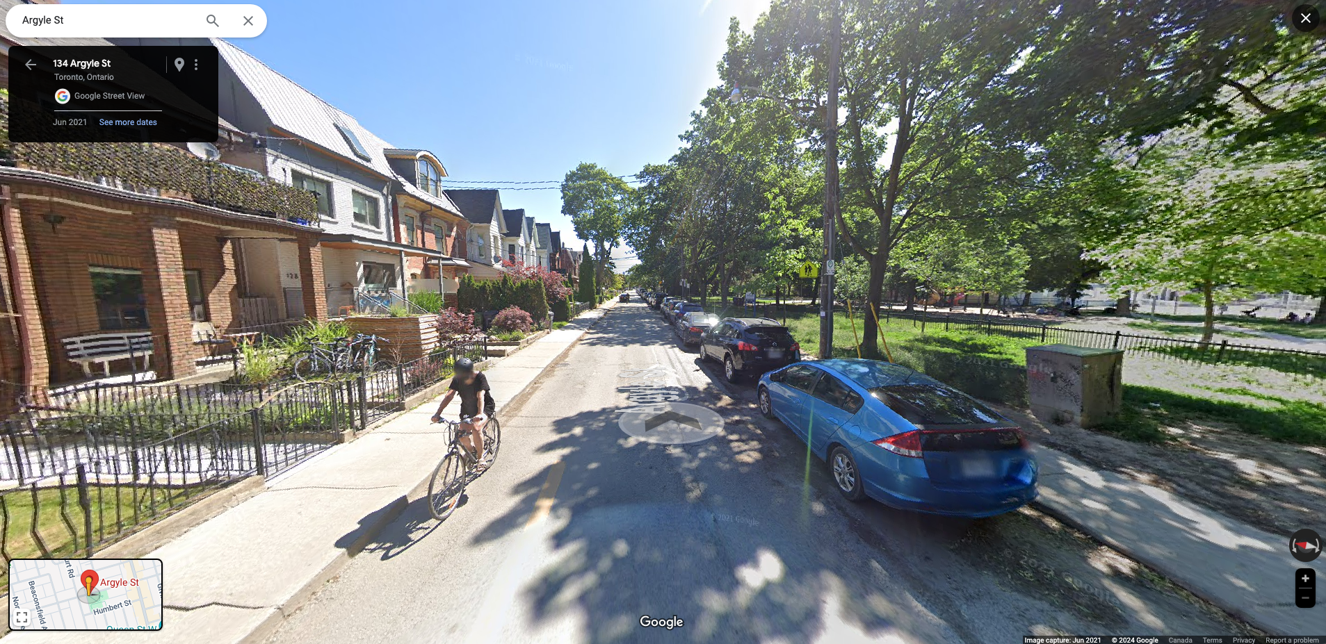
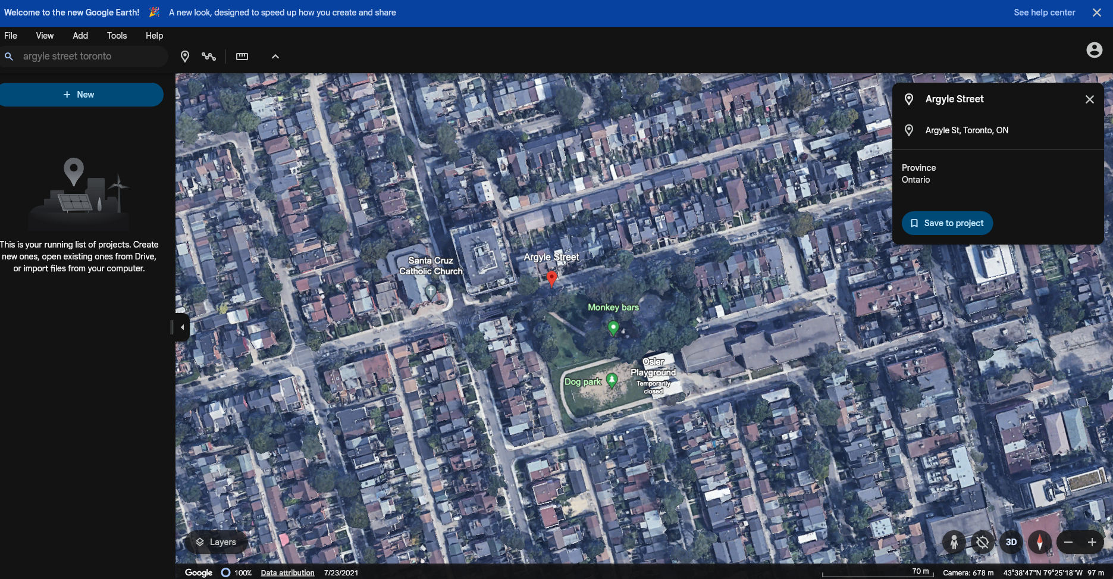

Methods (1): Verification of Installations and Upgrades

Slide 5



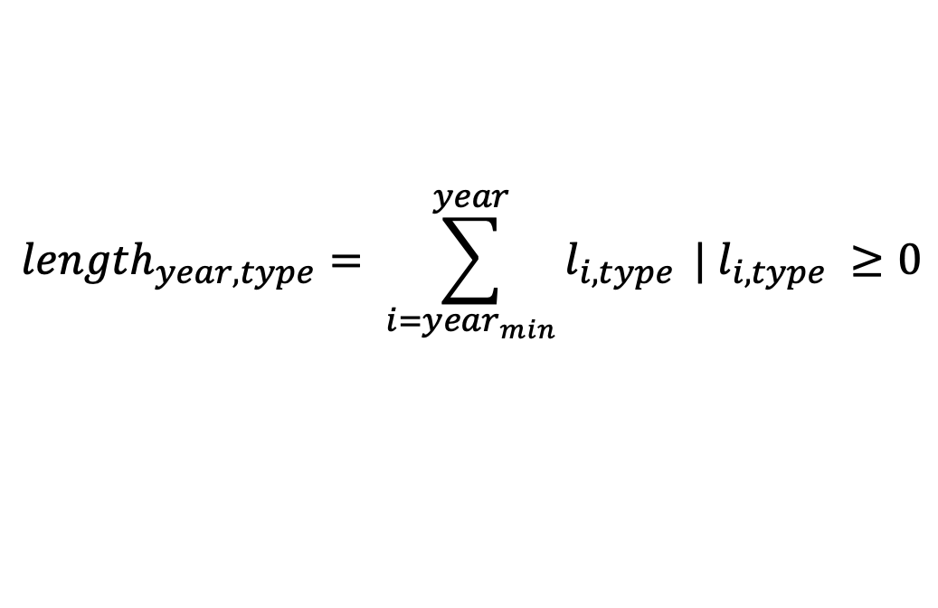
Methods (2): Calculations
Yearly Road Lengths
$${length}_{year, type}= \sum_{i={year}_{min}}^{year}{l_{i,type}} | l_{i,type} ≥0$$
Adjusted Yearly Road Lengths
$${length}_{year,type}^{install}+ {length}_{year,type}^{change}− {length}_{year,type}^{replacement}$$

Slide 6
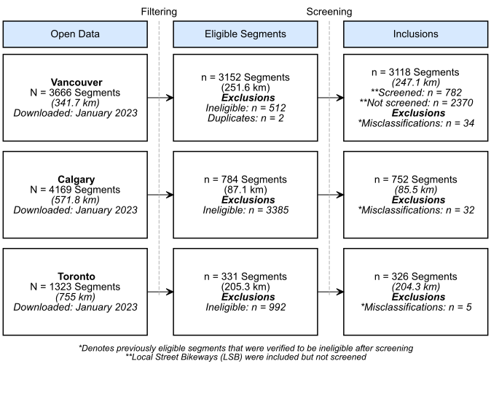
Results: Segment Inclusions and Exclusions
Painted Lanes (PL): solid/dashed lines separating cyclists from vehicle travel lanes, accompanied by signs or pavement markings to distinguish them as cycling routes
Buffered Lanes (BUF): painted lanes with wider painted areas marked with diagonal or chevron patterns
Cycle Tracks (CT): presence of a permanent vertical barrier such as bollards or raised curbs

Slide 7
Results: Installation Year Accuracy
74.5% Correct
78.2% ±1 Year
0 = Correct

Slide 8
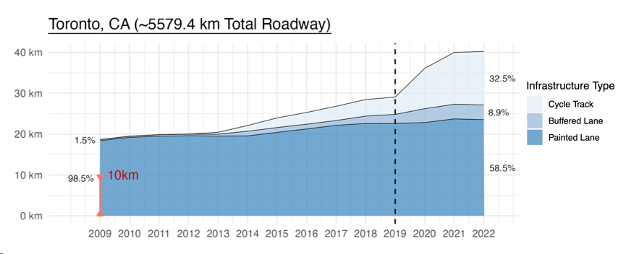
Results: Infrastructure per 1000 km of Roadway

Slide 9
Results: Changes Since January 2020

Slide 10
Questions
Why the difference in installation years (74.5% Correct, 78.2% ±1 Year)?
Are there finer installation and upgrade dates than by year?
e.g. semesters, quarters, months, or day
52 (22.32%) of 233 post-2011 installs with no quarter found
https://rrwen.github.io/recovr-eval/archive/check-toronto-bikeways/

Slide 11
Appendix: Net Change per 1000 km of Roadway

Slide 12
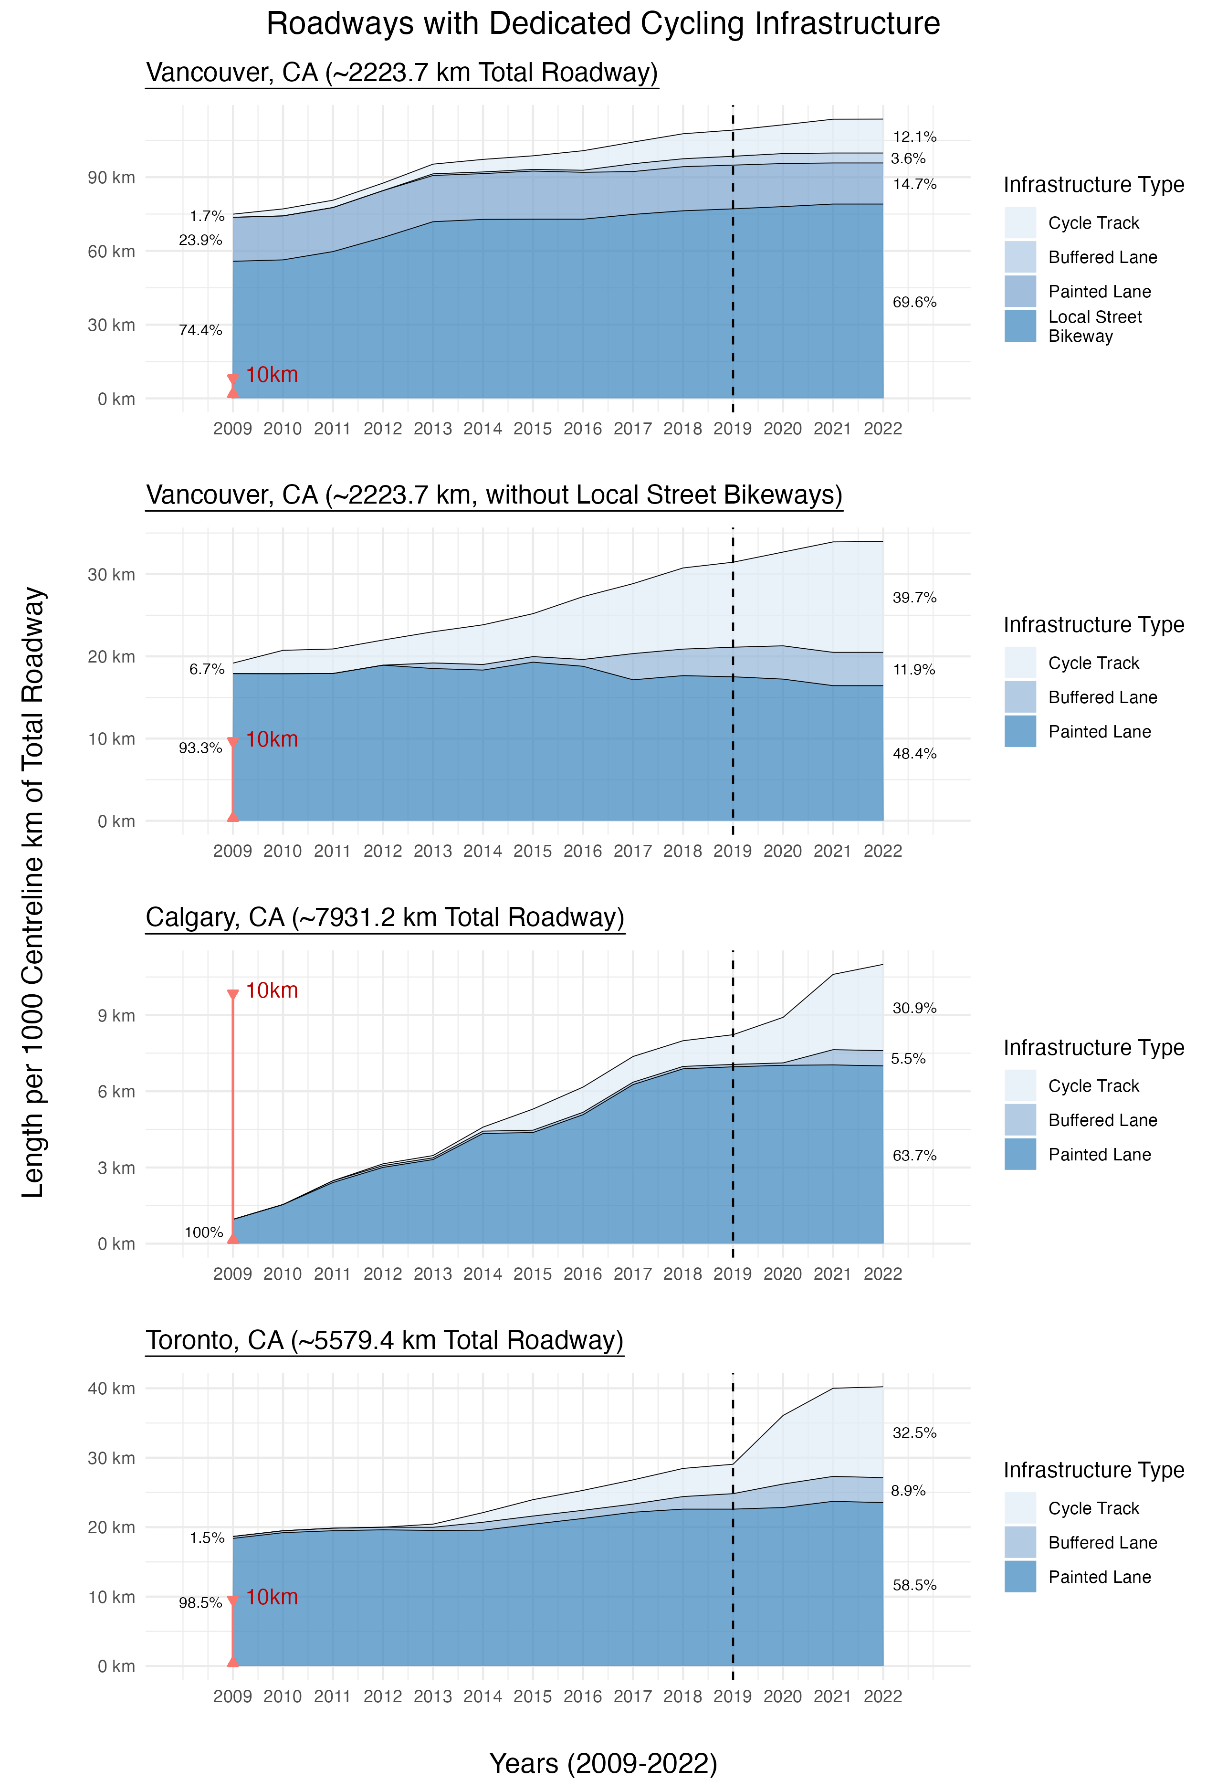
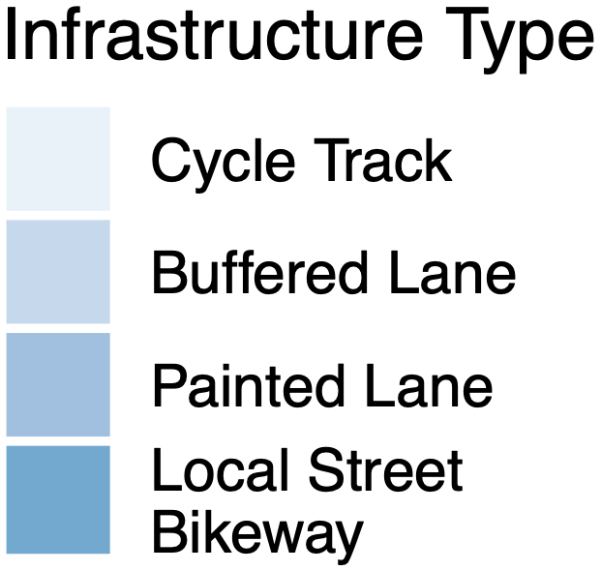
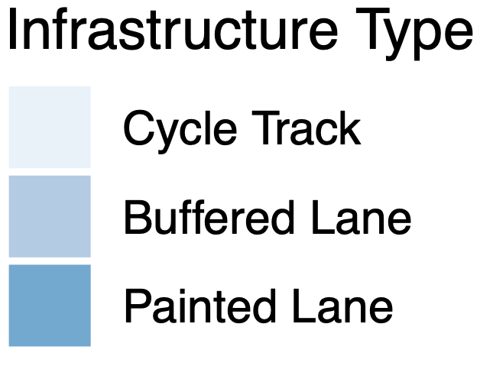
Appendix: Infrastructure per 1000 km of Roadway

